Slide 1

Traveling Safely
Greetings from Jonathon Scroggins

Slide 2
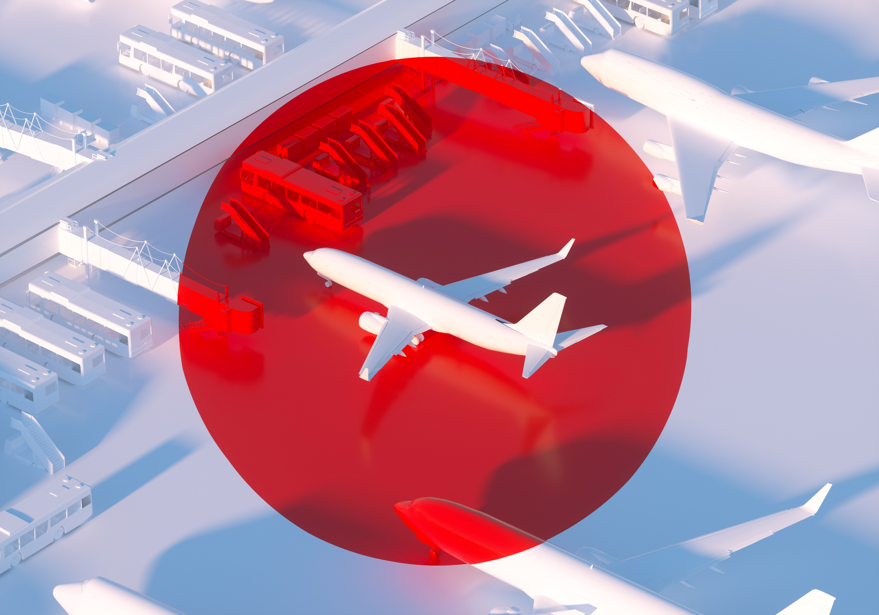

Would you rather…
FLY
Drive
OR

Slide 3

Safer?

Slide 4
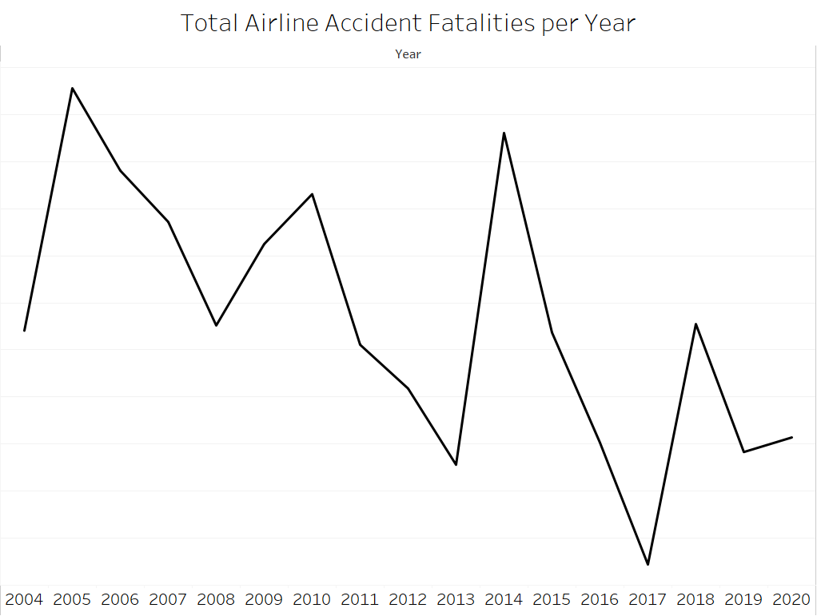
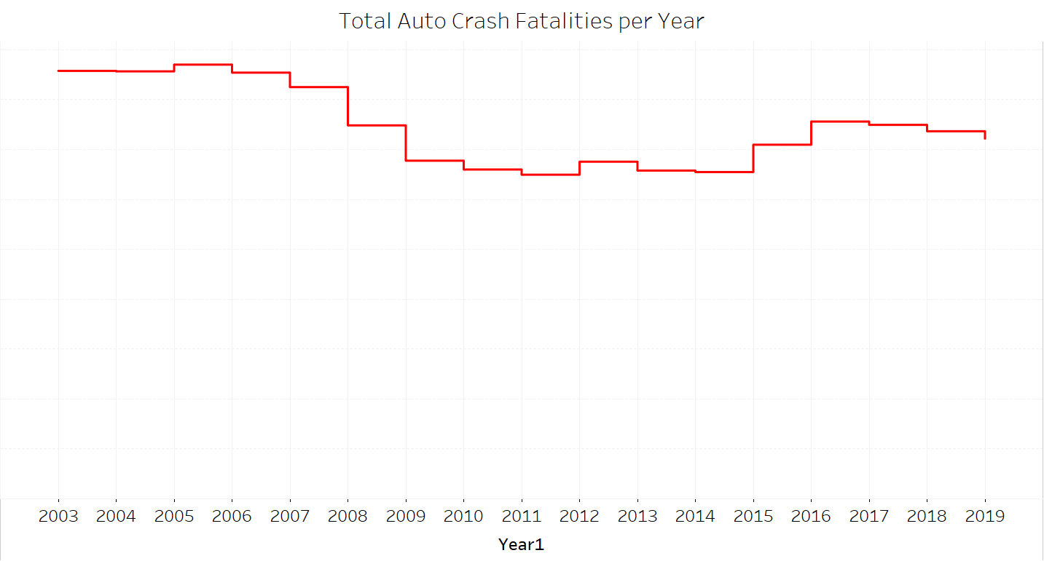
Let’s look at the trends...
Fatalities of both are trending down but...
...the fatalities of airlines trend changed much more significantly

Slide 5
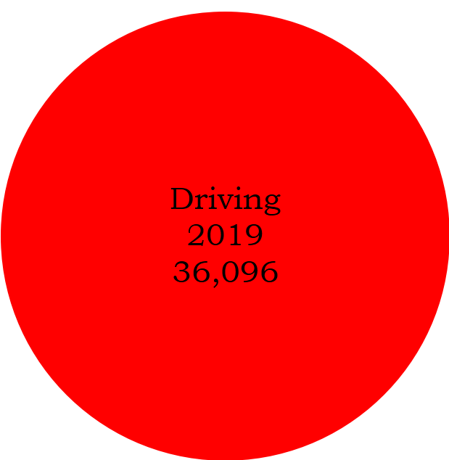
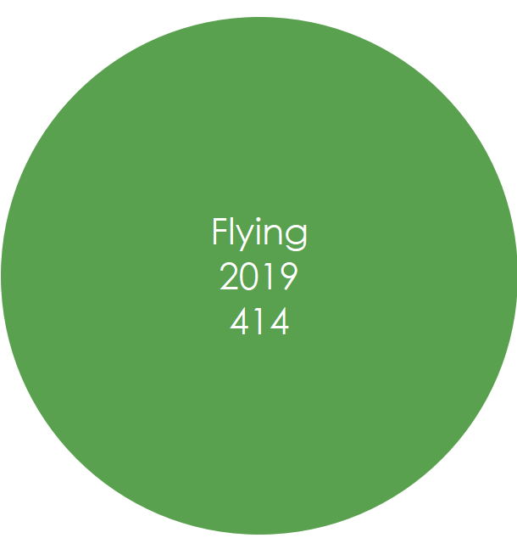
Let’s Look at the Numbers...
Total Fatalities

Slide 6
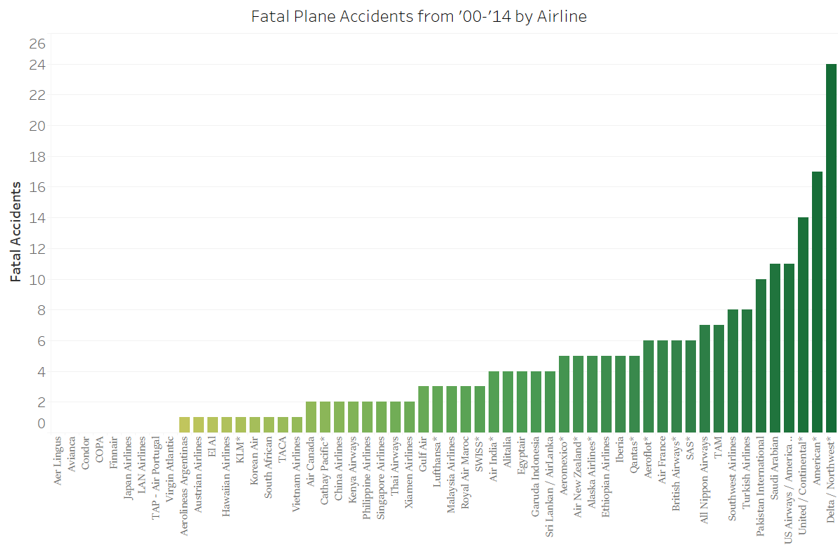

What about the total number of accidents?
Driving: 1,153,092
Airlines: 231

Slide 7
Whatever mode of transportation you choose, have the safe and fun vacation that you so richly deserve!

